Slide 1
Chapter 2
Protocols and Models
Module 3: Protocols and Models
Introduction to Networks v7.0 (ITN)

Slide 2
Objectives
2.1 Rules of Communications
2.2 Network Protocols and Standards
2.3 Protocols Suites
2.4 Data Encapsulation

Slide 3

2.1 Rules for Communications
All communication methods have three elements in common:
Sender (source)
Receiver (destination)
Channel ( transmission media)

Slide 4
Cont’d…
Before communicating with one another, individuals must use established rules or agreements to govern the conversation → Protocols
The protocols will define the following areas:
Sender and Receiver
Message Encapsulation
Message Encoding
Message Delivery Options
Message Timing
Message Size

Slide 5
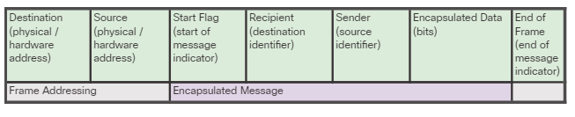
Message Encapsulation
When a message is sent from source to destination, it must use a specific format or structure.
Messages that are not correctly formatted are not successfully delivered to or processed by the destination host.

Slide 6
Message Encoding
Encoding is the process of converting information into another acceptable form, for transmission. Decoding reverses this process in order to interpret the information.
Messages sent across the network are first converted into bits. The bits are then encoded into a specific recognisable pattern before placing onto media.

Slide 7
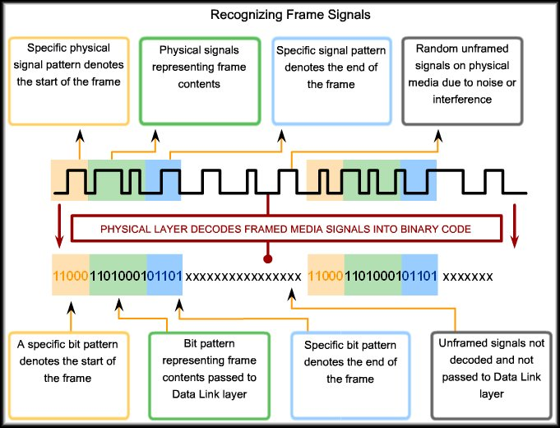
Cont’d…

Slide 8
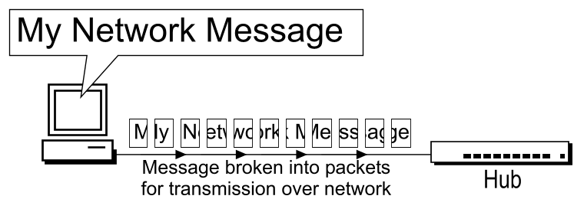
Message Size
When a long message is sent from one host to another over a network, it is necessary to break the message into smaller pieces, with each containing a part of the original message.
At the receiving host, the individual pieces of the message are reconstructed into the original message.

Slide 9
Message Timing
Message Timing involves:
Access Method
Hosts on a network need an access method to know when to begin sending messages and how to respond when errors occur.
Flow Control
In network communication, source and destination hosts use flow control methods to negotiate correct timing for successful communication (ie manage the rate of data transmission)
Response timeout
Hosts on the network also have rules that specify how long to wait for responses and what action to take if a response timeout occurs.

Slide 10
Message Delivery Options
Hosts on a network use various options to communicate:
Unicast
A one-to-one delivery option, where there is only a single destination for the message.
Multicast
A one-to-many delivery option, where the message is send to a group of hosts simultaneously.
Broadcast
A one-to-all message delivery option, where the message is send to all hosts in the network.

Slide 11
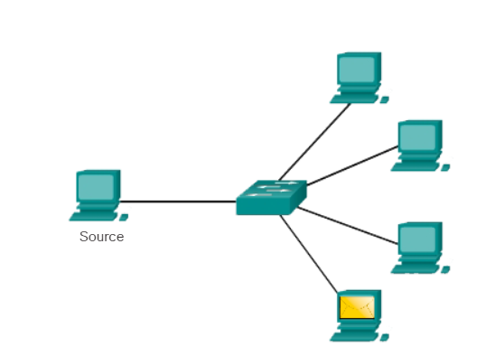
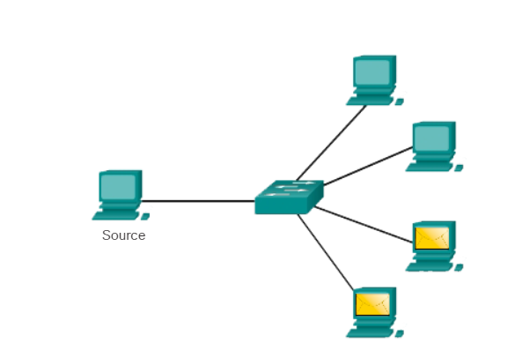
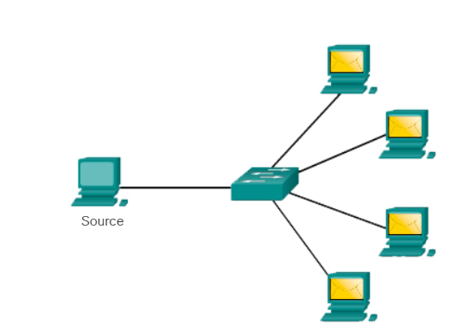
Multicast
Unicast
Broadcast

Slide 12
2.2 Network Protocols and Standards
Predetermined rules for network communication
It governs how network devices should communicate
The protocols determine the format of the message,
initiating and terminating communication session,
error handling, how data will be routed etc etc …
Eg. TCP, IP, HTTP, FTP, Ethernet

Slide 13
Examples
Protocol | Function
Hypertext Transfer Protocol (HTTP) | Governs the way a web server and a web client interact Defines content and format
Transmission Control Protocol (TCP) | Manages the individual conversations Provides guaranteed delivery Manages flow control
Internet Protocol (IP) | Delivers messages globally from the sender to the receiver
Ethernet | Delivers messages from one NIC to another NIC on the same Ethernet Local Area Network (LAN)

Slide 14
2.3 Protocol Suites
A protocol suite is a set of interrelated protocols that work together to provide comprehensive network communication services eg. TCP/IP, OSI, Apple Talk, Novell Netware

Slide 15
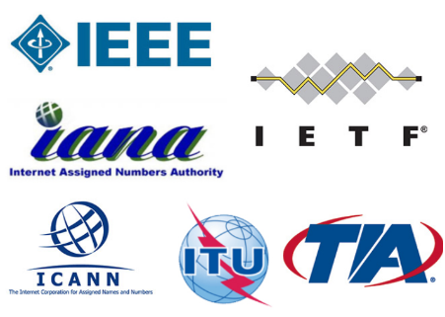
2.3.1 Standard Organizations
Vendor-neutral, non-profit organizations that established to develop and promote the concept of open standards.

Slide 16
Cont’d…
Internet Society (ISOC) - Promotes the open development and evolution of internet
Internet Architecture Board (IAB) - Responsible for management and development of internet standards
Internet Engineering Task Force (IETF) - Develops, updates, and maintains internet and TCP/IP technologies
Internet Research Task Force (IRTF) - Focused on long-term research related to internet and TCP/IP protocols
Internet Corporation for Assigned Names and Numbers (ICANN) - Coordinates IP address allocation, the management of domain names, and assignment of other information
Internet Assigned Numbers Authority (IANA) - Oversees and manages IP address allocation, domain name management, and protocol identifiers for ICANN

Slide 17
Cont’d…
Institute of Electrical and Electronics Engineers (IEEE) - dedicated to advancing technological innovation and creating standards in a wide area of industries including networking.
Electronic Industries Alliance (EIA) - standards related to electrical wiring, connectors, and network racks.
Telecommunications Industry Association (TIA) - standards for radio equipment, cellular towers, Voice over IP (VoIP) devices, and satellite communications.
International Telecommunications Union-Telecommunication Standardization Sector (ITU-T) - standards for video compression, Internet Protocol Television (IPTV), and broadband communications.

Slide 18

2.3.2 Networking Models - OSI
Earliest networks have no standardization, interoperability is an issue.
International Organization of Standards (ISO) developed a network reference model (conceptual framework) called OSI Model (Open Systems Interconnection).
OSI characterizes and standardizes the communication functions of a telecommunication or computing system regardless to their underlying internal structure and technology.

Slide 19
Cont’d…
OSI divides network operations into 7 layers (layered network model)
Each layers has its own functions and protocol(s) to follow
Data will flow through these layers from one end to another end.
OSI serves a framework for network design

Slide 20
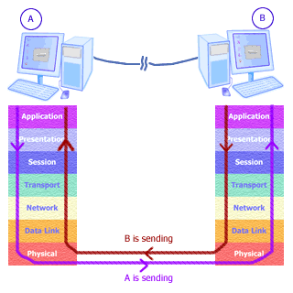

Slide 21
The OSI 7 Layers model
L7 APPLICATION layer
L6 PRESENTATION layer
L5 SESSION layer
L4 TRANSPORT layer
L3 NETWORK layer
L2 DATA LINK layer
L1 PHYSICAL layer

Slide 22
Cont’d…
Please Do Not Touch Steve’s Pet Alligator
Please Do Not Take Sausage Pizzas Away
Pew! Dead Ninja Turtle Smell Pretty Awful
All People Seem To Need Data Processing

Slide 23
Layer 7 Application
Performs services for the applications software used by the end users
Support process-to-process communications
Initiate necessary protocols eg. HTTP, FTP, SMTP, POP

Slide 24
Layer 6 Presentation
Performs data encryption/decryption and data conversion.
It serves as data translator / syntax translator
It transforms data into the form that the application layer can accept.
Eg. ASCII → EBCDIC

Slide 25
Layer 5 Session
It deals with communication session and connection
coordination.
It establishes, manages and terminates connections between applications.

Slide 26
Layer 4 Transport
Breaks data (into segments), numbers the segments, transfers the segments and reassembles the segments in the destination
Ensures complete data delivery (reliability) and handles error recovery
Sample of protocol(s) involved: TCP, UDP

Slide 27
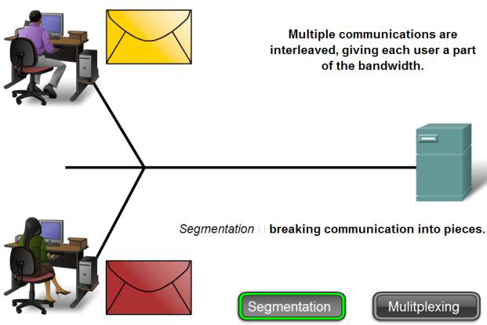

Slide 28
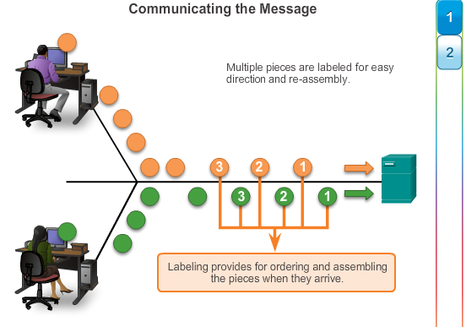

Slide 29
Layer 3 Network
Route and forward data to DIFFERENT LANs or WANs according to their logical address using best path → inter networks communication
Sample protocol(s) involved: IPv4, IPv6

Slide 30
Layer 2 Data Link
Concern about node-to-node delivery within the SAME network using the physical address→ intra network communication
Sample protocol(s) involved: Ethernet, Token Ring, PPP, CSMA/CD

Slide 31
Layer 1 Physical
It describes the mechanical, electrical, functional and procedure means of the transmission media.
It concern about the bit transmission to / from the network device.
Sample protocol(s) involved: RS-232, USB, Fiber Optic / Coax / Twisted Pair cable standards

Slide 32
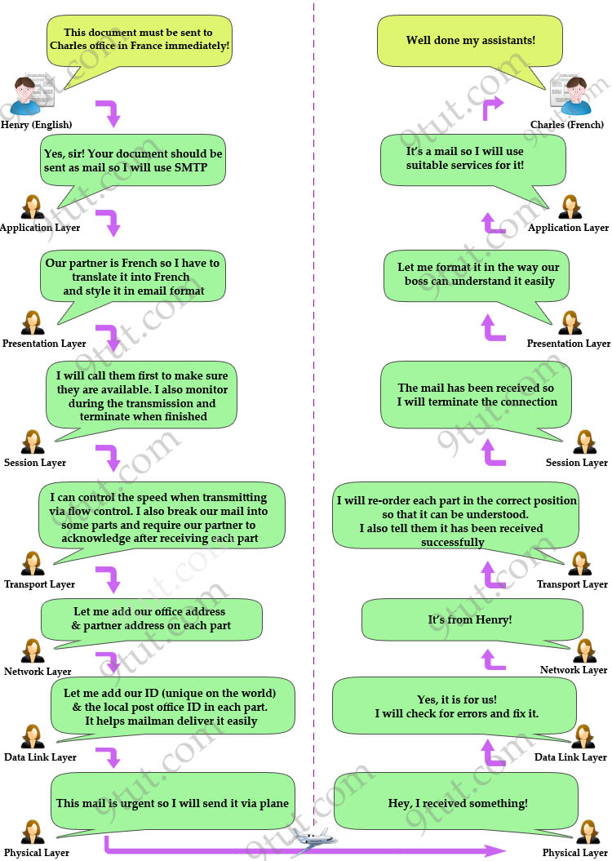

Slide 33
Benefits of Layered Model
Assists in protocol design as each layer has it own defined function and data to act upon
Allows products from different vendor to work together (common model for network communication)
Layer independence. Changes in one layer will not affect much on others
Providing a common language to describe networking functions and capabilities

Slide 34
2.3.3 Networking Models - TCP/IP model
Shorter version of OSI. Developed by US DOD and is widely used by most networks (aka DOD model)
It builds as the foundation of Internet. The Internet model is commonly referred to as the TCP/IP model.
It consists of 4 layers instead of seven:
L4 APPLICATION layer
L3 TRANSPORT layer
L2 NETWORK layer
L1 NETWORK ACCESS layer

Slide 35
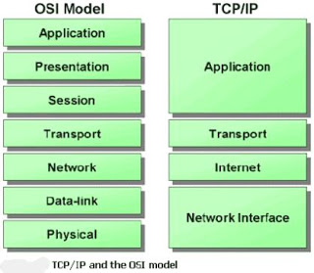
Upper
layers
Lower
layers

Slide 36
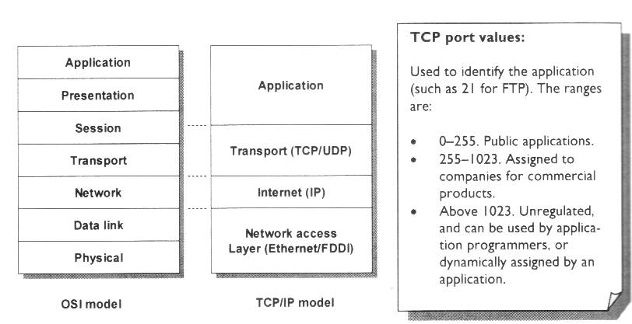

Slide 37
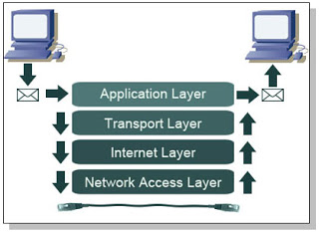

Slide 38
2.3.4 OSI vs TCP/IP
The OSI is a conceptual (theoretical) model, while TCP/IP is just an implementation of the OSI
The OSI model clearly distinguishes between services and protocols but TCP/IP does not
The OSI model has 7 layers but TCP/IP model has only 4 layers
In OSI model, the protocols came after the model
In TCP/TP model, the protocols came first, and the model was really just a description of the existing protocols.

Slide 39
2.4 Data Encapsulation
As application data is passed down network layers, various protocol information is added at each level.
When application data is passed up the network layers, the protocol information is removed at each level.

Slide 40
Encapsulation / De-encapsulation
Encapsulation
computer adds networking headers (control information) and trailers to data before transmitting
De-encapsulation
computer removes networking headers and trailers
Encapsulation happens in the sender side while de-encapsulation happens in the receiver side
Data with header and trailer added is known as Protocol Data Unit (PDU)

Slide 41
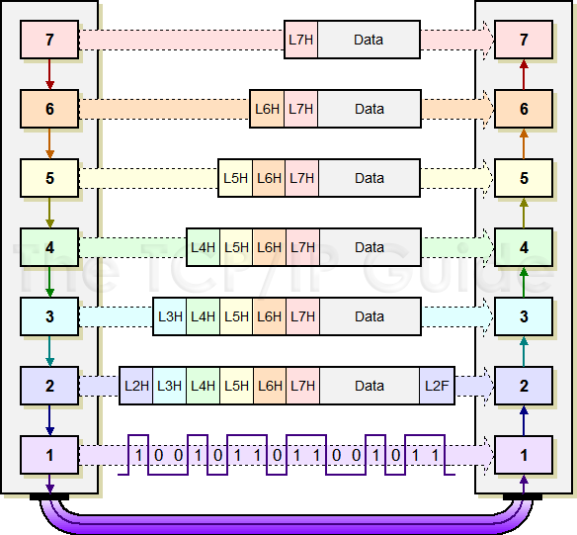
Protocol Data Unit (PDU)
Application
Presentation
Session
Transport
Network
Data Link
Physical

Slide 42
In TCP/IP model …
L7 – L5 PDU is generally know as Message / Data Stream
L4 PDU is known as Segment (datagram)
L3 PDU is known as Packet
L2 PDU is known as Frame
L1 PDU is know as Bit

Slide 43
Data Encapsulation in TCP/IP model
Application Layer creates Data Stream
Data stream is segmented and passed down to Transport Layer. Transport Header is added to the data→ Segment
Segment is then passed down to Internet Layer. Internet Header (eg. logical address of source and destination) is added to the segment → Packet

Slide 44
Cont’d…
Packet is then passed down to Network Access Layer. Network Header (eg. physical address, MAC) and Network Trailer (eg. FCS) are added to the packet → Frame
Frame is then converted into Bits (“1” and “0”) to be transmitted over the media

Slide 45
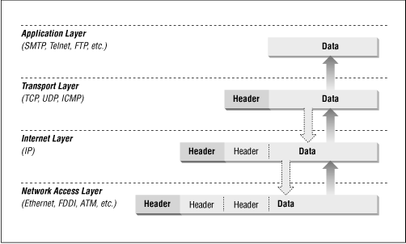

Slide 46
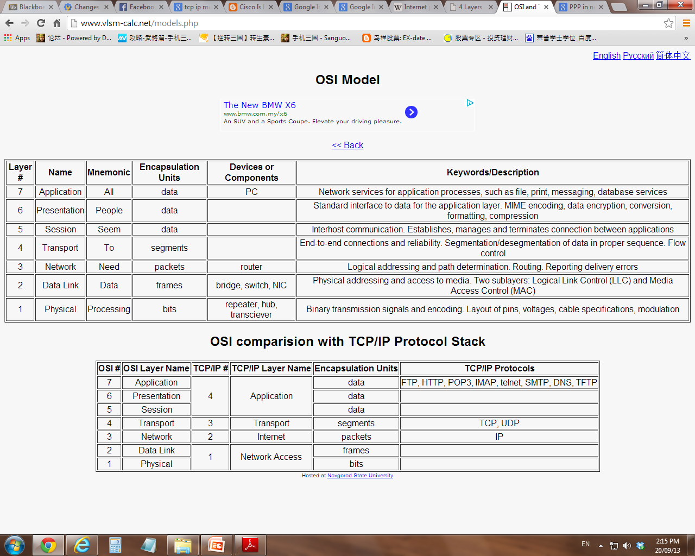

Slide 47
2.4.1 Addressing in Network
Network address serves as a unique identifier for a computer on a network.
For a data to be sent and received successfully, a few types of address need to be included.
Eg. MAC address, IP address, Port number

Slide 48
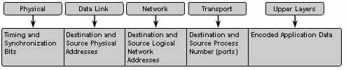
MAC address
Similar to your IC
Media Access Control address
An unique 48-bit/64-bit physical address associated with a NIC (hardcoded)
Aka hardware address or physical address
Is used to identify a host within a network
Expressed in Hex format. Eg. 01-23-45-67-89-AB
MAC address is needed by Data Link Layer to move the data to the correct end device within a network
The address is included in L2 Frame header

Slide 49
IP address
Similar to your home address
Logical address of a host
Is used to identify a host in other networks. (which network you are in?) Eg. 198.162.1.1
IP address is needed by Network Layer to move the data to the correct end device across networks
The address is included in L3 Packet header

Slide 50
Cont’d…
Each computer on the network has both IP address and MAC address assigned to it.
They are used to determine the source and destination of the message.

Slide 51
Port number
There are many applications running on a host computer
Each application runs on a port, eg. FTP – 21, HTTP – 80
Port number is needed by the Transport Layer to move the data to the correct application
The address is included in L4 Segment header

Slide 52
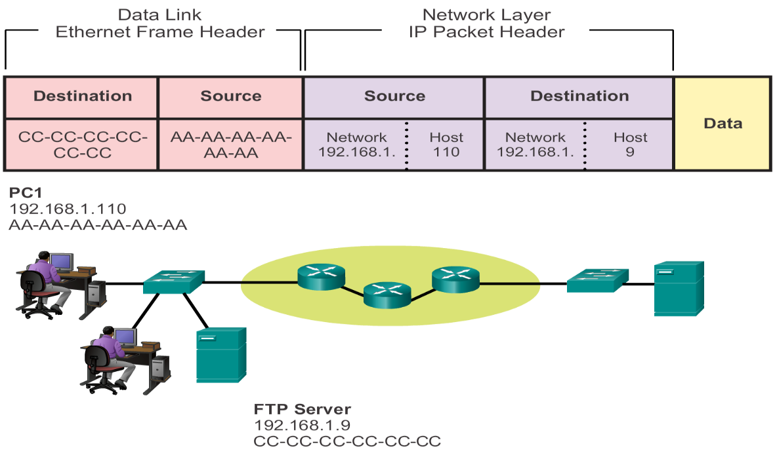
Accessing device on a Local Network Communicating with Device / Same Network
PC1 and FTP Server are
in the same network

Slide 53
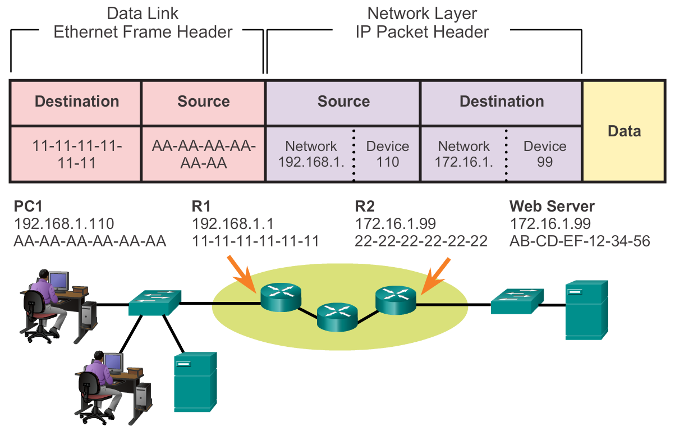
Accessing device on a Remote Network Communicating Device / Remote Network
sender
receiver

Slide 54
Summary
Rules of Communications
Network Protocols and Standards
Protocols Suites
Data Encapsulation

